Slide 1
Batch Learning and Online Learning
college To corporate

Slide 2
BATCH LEARNING
In batch learning, the system is incapable of learning incrementally: it must be trained using all the available data
This will generally take a lot of time and computing resources, so it is typically done offline.
First the system is trained, and then it is launched into production and runs without learning anymore; it just applies what it has learned. This is called offline learning.
If you want a batch learning system to know about new data (such as a new type of spam), you need to train a new version of the system from scratch on the full dataset (not just the new data, but also the old data), then stop the old system and replace it with the new one

Slide 3
BATCH LEARNING
Also, training on the full set of data requires a lot of computing resources (CPU, memory space, disk space, disk I/O, network I/O, etc.). If you have a lot of data and you automate your system to train from scratch every day, it will end up costing you a lot of money. If the amount of data is huge, it may even be impossible to use a batch learning algorithm.

Slide 4
Online learning
In online learning, you train the system incrementally by feeding it data instances sequentially, either individually or by small groups called mini-batches. Each learning step is fast and cheap,
Online learning is great for systems that receive data as a continuous flow (e.g., stock prices) and need to adapt to change rapidly or autonomously. It is also a good option 16 if you have limited computing resources: once an online learning system has learned about new data instances, it does not need them anymore, so you can discard them (unless you want to be able to roll back to a previous state and “replay” the data). This can save a huge amount of space.

Slide 5
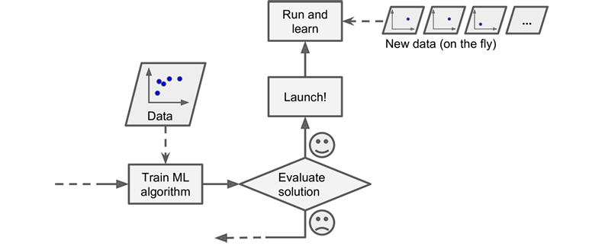
Online learning
A big challenge with online learning is that if bad data is fed to the system, the system’s performance will gradually decline To reduce this risk, you need to monitor your system closely and promptly switch learning off (and possibly revert to a previously working state) if you detect a drop in performance. You may also want to monitor the input data

Slide 6
out-of-core learning
Online learning algorithms can also be used to train systems on huge datasets that cannot fit in one machine’s main memory (this is called out-of-core learning). The algorithm loads part of the data, runs a training step on that data, and repeats the process until it has run on all of the data
Out-of-core learning is usually done offline

Slide 7
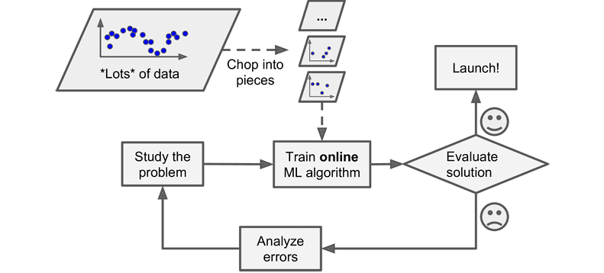
out-of-core learning

Slide 8
What is learning rate
One important parameter of online learning systems is how fast they should adapt to changing data: this is called the learning rate. If you set a high learning rate, then your system will rapidly adapt to new data

